Slide 1


Obstacle Avoidance for Ground Robot

Slide 2
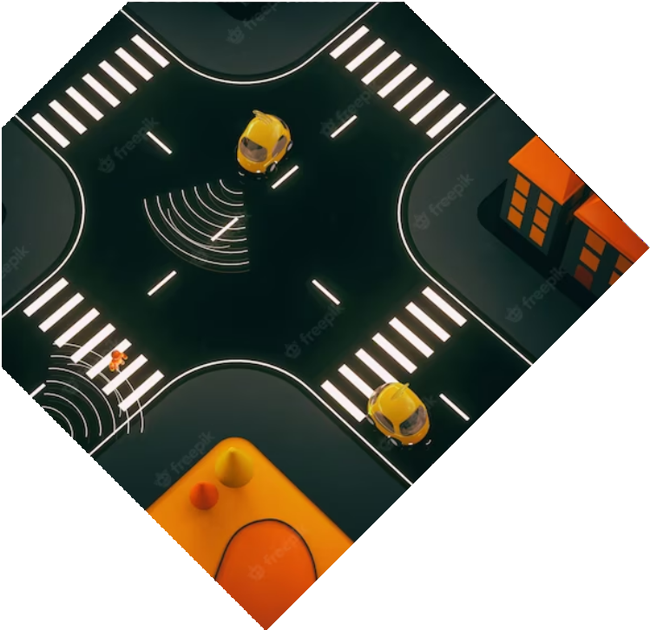

I N D E X
Motivation
Implementation
Components Required
Timeline
Summary

Slide 3

Motivation
We all know robots are becoming increasingly important in our lives, doing tasks from delivering packages to exploring unknown places. But there’s a big challenge they face: how to move around without bumping into things. Our project, “Obstacle avoidance for ground robots”, is all about solving this problem.
We want to make sure that robots can move around safely and efﬁciently. We would be using Potential
Field Method to avoid obstacle, by simulating attractive forces towards the goal and repulsive forces from obstacles. This method offers a versatile way to
plan paths while avoiding collisions.

Slide 4
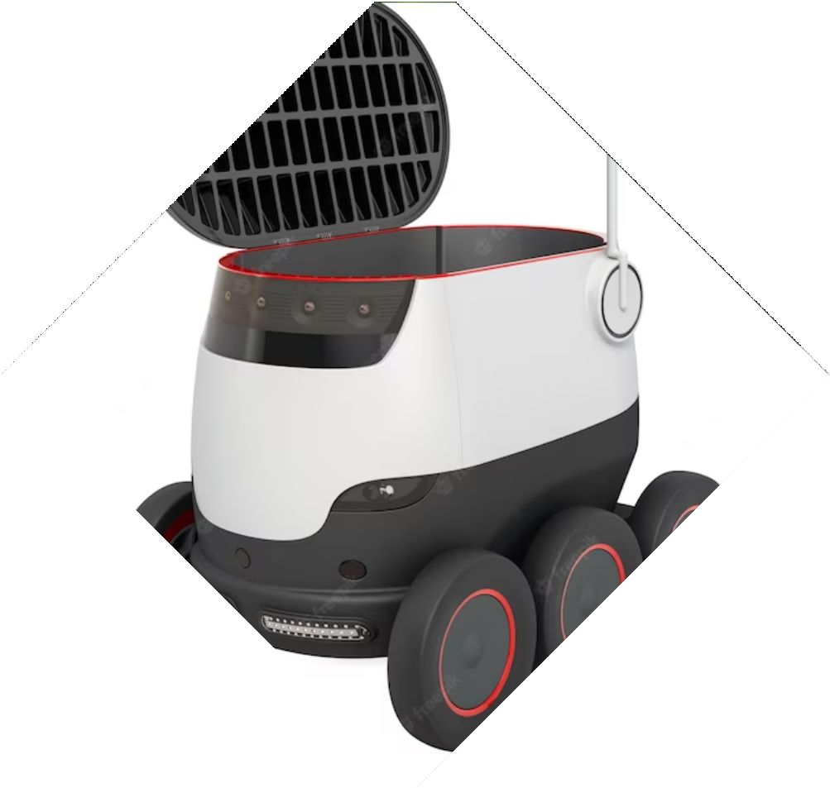

Some other Key Points:
Safety enhancement: Ensuring that robots can navigate around obstacles in real-time, without collisions, is essential to prevent accidents and damage.
Autonomous Exploration: Autonomous obstacle avoidance is vital in enabling these robots to navigate challenging and unknown terrains effectively for crucial applications such as search and rescue, and delivering items to their desired location without damaging the item itself.

Slide 5

What is the Potential Field
Algorithm?
To implement this project, we will use the Potential Fields Method algorithm. The algorithm represents the ﬂoor as a grid and uses a window to monitor the robot's surroundings.
Ultrasonic sensors detect obstacles and their distances. The algorithm applies repulsive and attractive forces to the robot based on the distances. The robot moves along the resultant force vector by adjusting the motors. This process continues
until the robot reaches its destination.

Slide 6
Implementation
The project involves the implementation of obstacle detection and avoidance using an ultrasonic sensor (HC-SR04) and a stepper motor-controlled wheel system. The core of the algorithm is executed on an Arduino Nano platform. To achieve obstacle avoidance, we use a method called "Potential Field Algorithm". This method makes use of the distance data obtained from the sensor to guide the robot around obstacles within a predefined matrix. The robot is tasked with starting from a designated start line and moves through the matrix while adjusting its direction based on calculations from the potential field algorithm to avoid any encountered obstacles. The objective is for the robot to reach a designated end line, at which it will detect the presence of the end line's and stop moving. This project combines sensor technology, motion control and intelligent algorithms like potential field method to create an autonomous obstacle-avoiding robot capable of navigating environments without colliding with obstacles from start line to finish line.

Slide 7
Components Required
Chassis (Ready Made)
Ultrasonic Sensor (x6)
Castor Wheel (x1)
Wheels (x2)
Stepper Motors (x2)
Jumper Wires
Breadboards (small x2)
Aruduino Nano (x1)
Motor Driver L293D (x1)
Lippo Battery (9V x1)
Motor Brackets

Slide 8

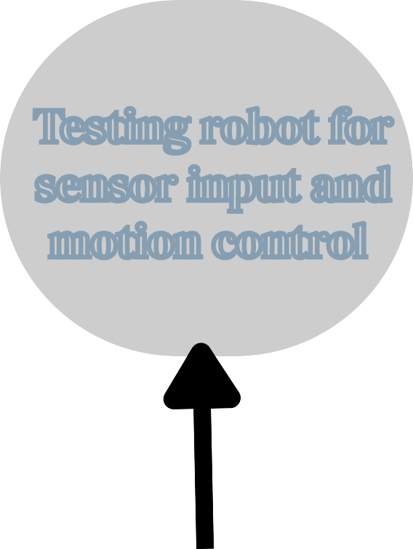
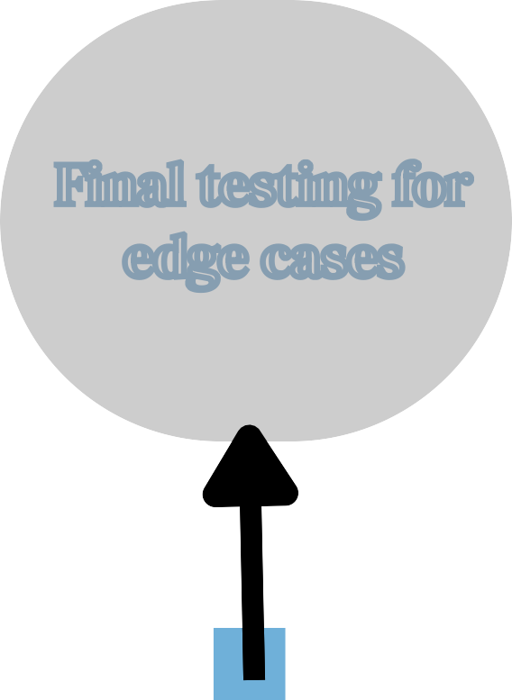
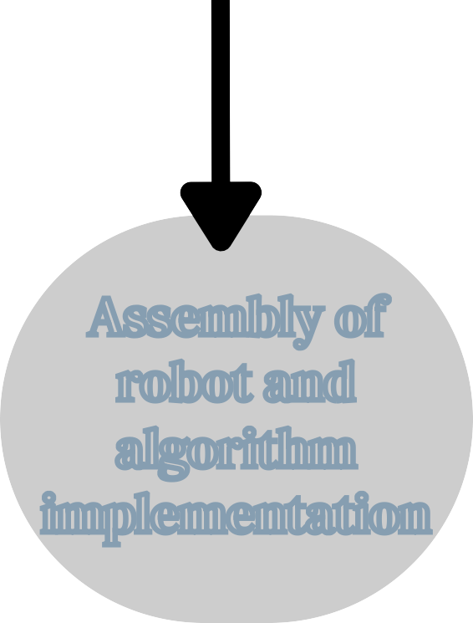

Testing robot for sensor input and motion control
Testing and Hardware Interfacing
Final testing for edge cases
Timeline
Week
3-4
7-8
1-2
5-6
9-10
Assembly of robot and algorithm implementation
Improving on software and testing

Slide 9
Summary
Our project focuses on developing an advanced obstacle avoidance system for ground robots which uses ultrasonic sensors to sense the distance between our robot and obstacles, using this distance data we calculate the repulsive force that the obstacle would impart on our robot and based on the resultant force on our ground robot we determine the path towards our ﬁnal destination.

Slide 10
Thanks!
Team 5
Group 9
Members:
Vinit Mehta 2022111001
Abhinav Raundhal: 2022101089
Yash Shinde: 2022111009
Samyak Mishra: 2022101121

